Slide 1
CS-250 Final Project
Agile Methodology: Transforming Project Management for Leadership
December 7, 2023

Slide 2
Agenda
Agile Methodology: Transforming Project Management
Embracing Agility in Project Management
Key Roles in Scrum-Agile Teams
Navigating through Agile Software Development Life Cycle (SDLC)
Agile vs. Waterfall Methodology
Agile in Action: Addressing Development Challenges
Agile or Waterfall: Making the Right Choice
Integrating Agile for Project Success
References

Slide 3
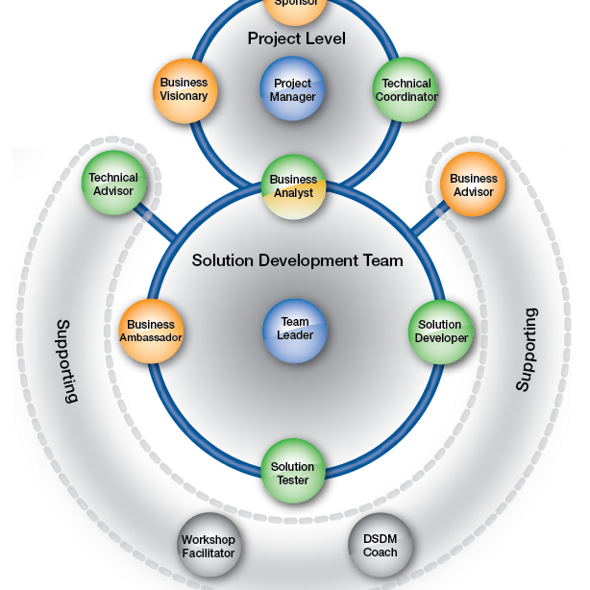
Agile Methodology: Transforming Project Management
Key Points
Agile is a project management and product development approach centered around iterative development.
Scrum, a subset of Agile, allows teams to work on complex projects and deliver high-value products adaptively.
Agile methodologies emphasize flexibility, customer collaboration, and frequent feedback.
The traditional Waterfall approach is compared with Agile throughout the presentation.

Slide 4
Embracing Agility in Project Management
Definition of Agile
Agile is a project management and product development approach that is centered around iterative development, where requirements and solutions evolve through collaboration between self-organizing cross-functional teams.
Introduction to Scrum
Scrum is a subset of Agile. It is a framework that allows teams to work on complex projects and deliver high-value products by approaching problems adaptively.
Scrum in Action
Scrum sets the stage for the team to self-organize and make quick, informed decisions. It includes the roles of Product Owner, Scrum Master, and Development Team.

Slide 5
Key Roles in Scrum-Agile Teams
Product Owner
Scrum Master
Development Team
Manages the product backlog and ensures the team delivers value to the business.
Facilitates Scrum processes and removes impediments. Acts as a coach to the team in Agile practices.
Cross-functional team members who develop the product. They are self-organizing and responsible for delivering high-quality increments.

Slide 6
Navigating through Agile Software Development Life Cycle (SDLC)
Concept and Initiation
Brainstorming and defining the scope of the project.
Development
Iterative development of product increments.
Requirements and Planning
User stories and backlog creation.
Testing
Continuous testing in parallel with development.
Design and Prototyping
Creating design models and prototypes.
Deployment
Regular and incremental release of product features.

Slide 7
Agile vs. Waterfall Methodology
Agile
Waterfall
Characterized by iterative and incremental development.
Emphasizes flexibility and customer feedback.
A linear and sequential approach.
Each phase must be completed before the next begins.
Less flexibility once the project is underway.

Slide 8
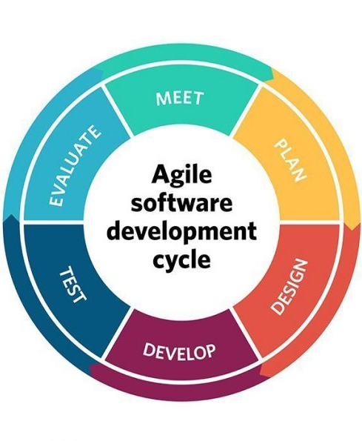
Agile in Action: Addressing Development Challenges
Case Study Example
The Challenge: Changing customer requirements in the middle of the development phase.
Agile Solution: Embracing change as a competitive advantage. Using iterative development to incorporate changes smoothly and quickly.
Waterfall Comparison: In a traditional phase, changing requirements would cause delays and budget overruns.
Impact: Agile approach minimizes disruption and ensures continuous progress.

Slide 9
Agile or Waterfall: Making the Right Choice
Agile Suitability
Customer Involvement
Risk Management
Agile is suitable for complex projects with variable scope. Waterfall works well for simple, well-defined projects.
Agile requires continuous customer involvement. Waterfall involves customers primarily at the beginning and end.
Agile allows for early and frequent risk assessment. Waterfall carries risks towards the end of the project cycle.

Slide 10
Integrating Agile for Project Success
01
02
03
Summary of Agile benefits and its impact on modern project management.
Encouraging leadership to consider Agile for its adaptability, customer-centric approach, and effective risk management.
Additional note about the importance of Agile in the current business landscape.

Slide 11
References
'Agile Project Management with Scrum' by Ken Schwaber.
'Succeeding with Agile: Software Development Using Scrum' by Mike Cohn.
'User Stories Applied: For Agile Software Development' by Mike Cohn.
'Agile Estimating and Planning' by Mike Cohn.
'The Agile Samurai: How Agile Masters Deliver Great Software' by Jonathan Rasmusson.
'Scrum: The Art of Doing Twice the Work in Half the Time' by Jeff Sutherland.

